Slide 1






STROKE PREDICTION BASED ON RISK FACTORS
Kelly Blake
Rajeshwari Radhakrishna
Aisha Henderson
Elona Barjami

Slide 2



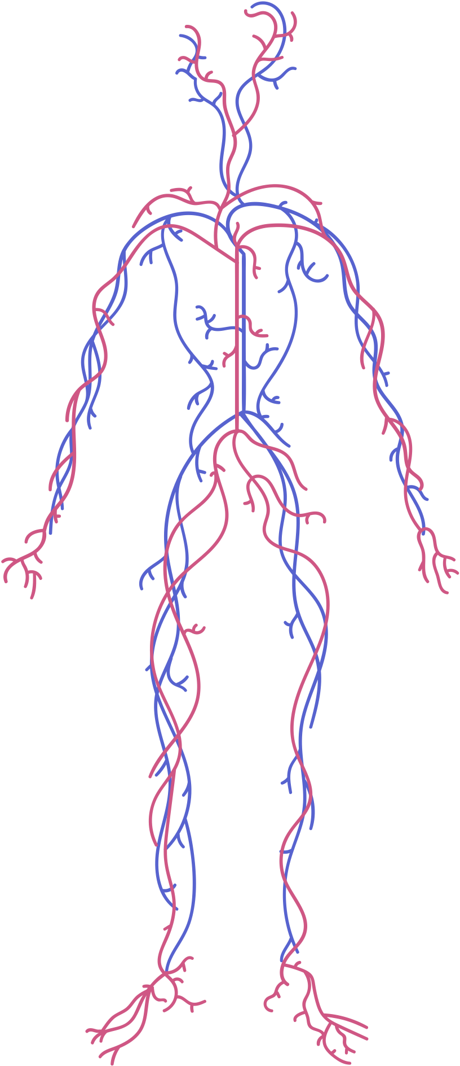
INTRODUCTION
What is a Stroke?
"A stroke, sometimes called a brain attack, occurs when something blocks blood supply to part of the brain or when a blood vessel in the brain bursts. In either case, parts of the brain become damaged or die. "
-Centers for Disease Control and Prevention (CDC)
Understanding the Impact:
"Stroke is the No. 5 cause of death and a leading cause of disability in the United States."
-American Stroke Association

Slide 3
The ‘What’:
The ‘How’:
Utilizing a stroke dataset and statistical analysis tools, our objective is to determine individuals who have a higher likelihood of experiencing a stroke based on certain risk factors
With the sample population in the stroke dataset, our team will be using statistical analysis and visualization to analyze the correlation and impact of risk factors and the occurrence of strokes in individuals
Research Questions
01
Does a person’s residency type increase the risk of having a stroke, for Urban vs. Rural residents?
02
Are males over 60 at a higher risk of having a stroke compared to males 20-59?
Does smoking status impact the risk of stroke for males?
03
Are patients with hypertension vs patients with heart disease more likely to have a stroke?

Slide 4
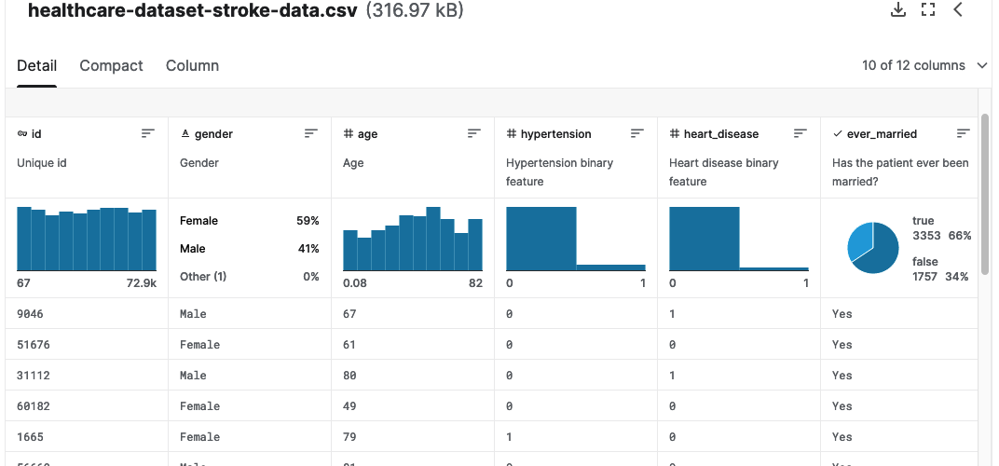
Dataset Information
Source: Stroke Prediction Dataset, Kaggle.com
Columns Used in Clean Data Frame:
Column Details:
ID | Unique Identifier
Gender | ”Male”, “Female”, or “Other”
Age | Age of the patient
Hypertension | 0 – The patient doesn’t have hypertension 1 – The patient has hypertension
Heart Disease | 0 – The patient doesn’t have any heart disease 1 – The patient has a heart disease
Residence Type | ”Rural” or “Urban”
Smoking Status | “Formerly Smoked”, “Never Smoked”, “Smokes”, or “Unknown”
Stroke | 1 – The patient had a stroke 0 – The patient did not have a stroke
This dataset contains information on over 5000+ unique individuals who have or have not had a stroke

Slide 5
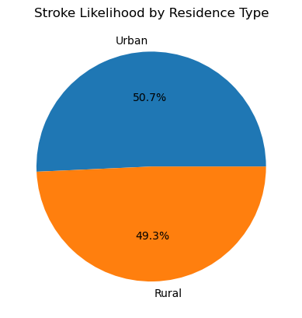
Comparing the Rate of Stroke by Residency Type:
Urban vs Rural
Statistical Analysis
Chi-square statistic: 0.123
p-value: 0.724
Findings:
Given the p-value calculation is > 0.05, this indicates there is no association between the two variables on the risk of stroke based on residence type.

Slide 6
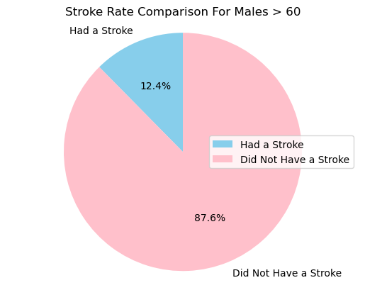
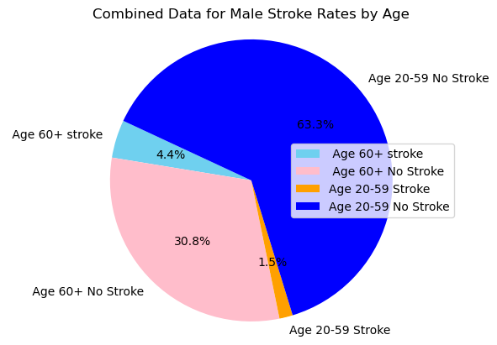
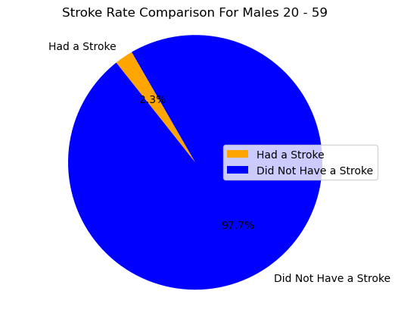
What’s in a Number?: Comparing the Rate of Stroke for Males Over Age 60 and Males Between 20 – 59 Years
Key Findings:
The rate of stroke for males over 60 is 4.4%
The rate of stroke for males between 20-59 is 1.5%

Slide 7
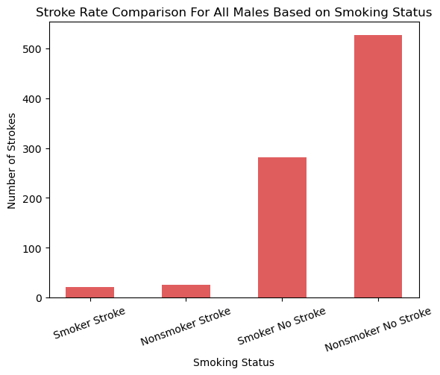
Comparing the Rate of Stroke for Smokers vs Non-Smokers
“Smoking is the leading cause of statistics” –Fletcher Knebel
This analysis seeks to determine the rate of stroke for Male Smokers vs the rate of stroke for Male Non-Smokers
Smokers are defined as someone who is a current smoker
Non-smokers are defined as someone who never smoked
Findings:
Based on the data above
25 male non-smokers had a stroke
21 male smokers had a stroke
The rate of stroke for non-smokers is 3%
The rate of stroke for smokers is 2%
Based on an independent T-test performed, the p-value result of 0.160 indicates that smoking status is not statistically significant in determining the risk of stroke.

Slide 8
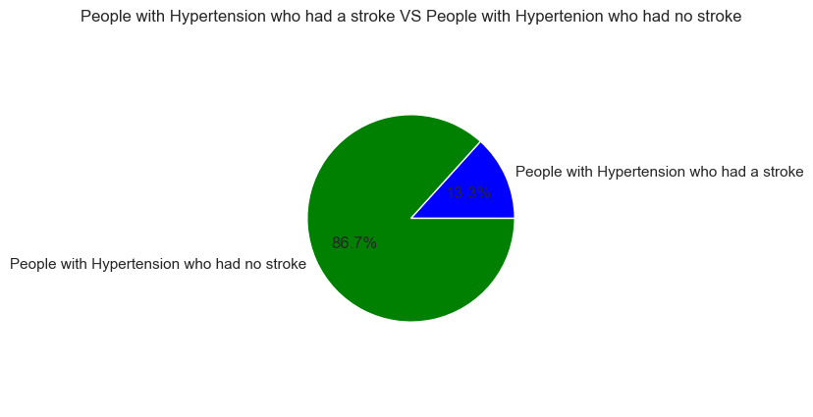
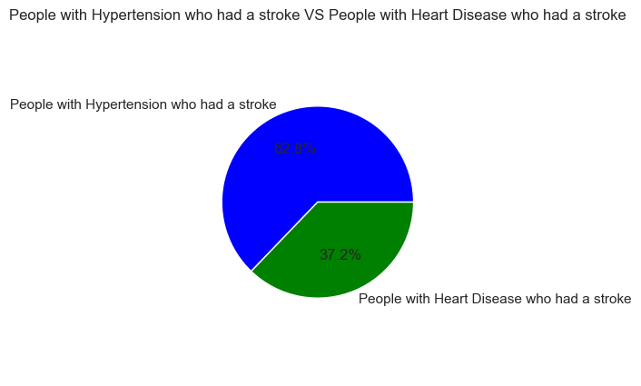
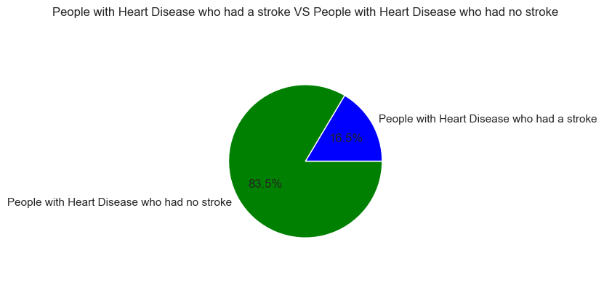
Stroke Rate Comparison for Hypertension vs Heart Disease
Key Findings:
Hypertension is the biggest risk factor for stroke. The percentage of people with hypertension who had a stroke is greater than the percentage of people with heart disease who had stroke as shown in the Pie chart below.
The percentage of people with hypertension who did not have a stroke is greater than the percentage of people who have hypertension and did have a stroke.
The percentage of people who have heart disease got stroke is higher than percentage of people who doesn't have heart disease got stroke.

Slide 9
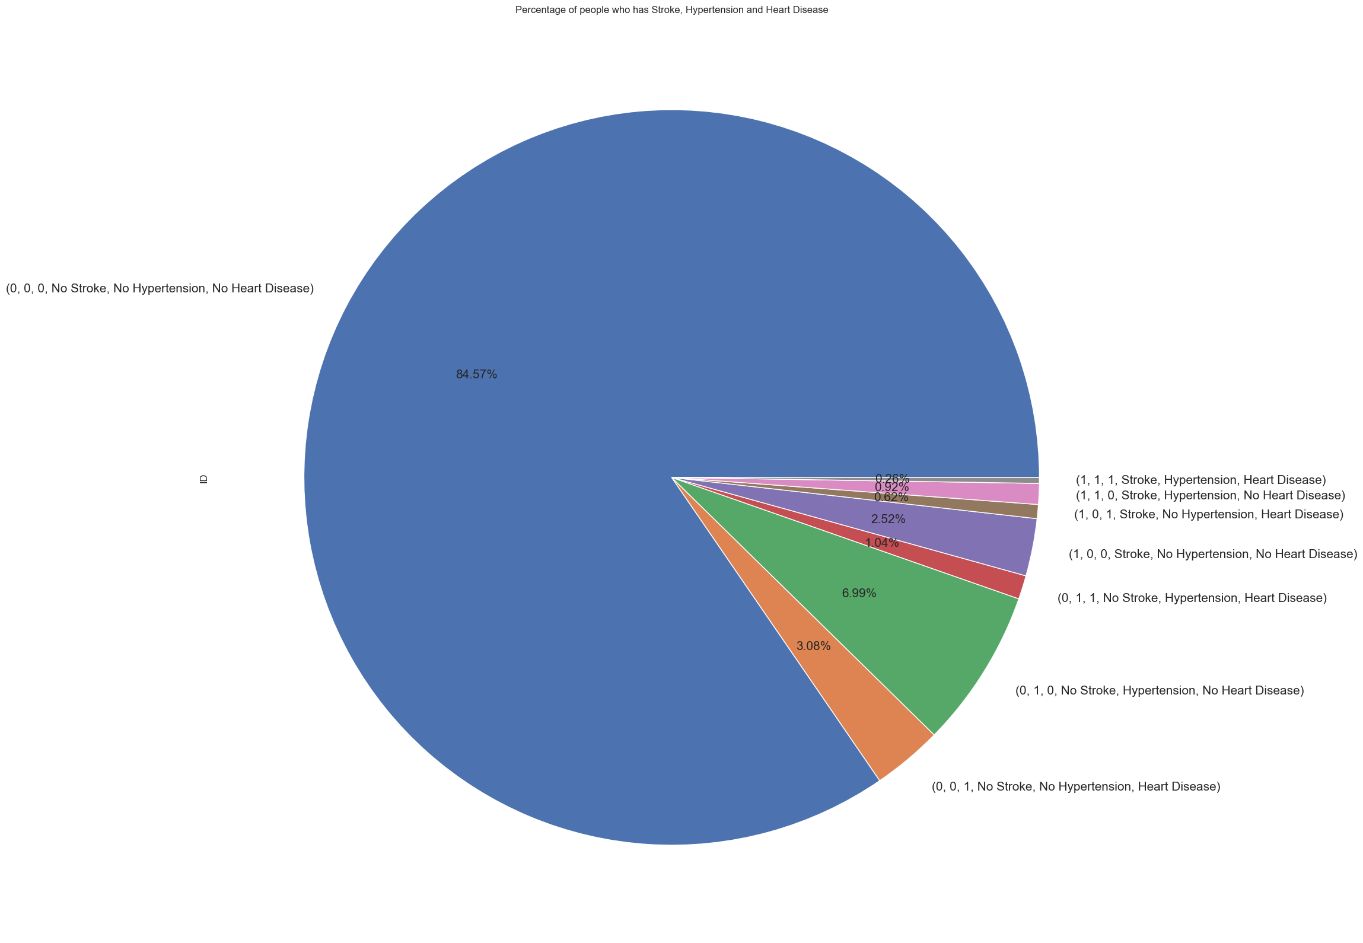
Combined Data:
Hypertension vs Heart Disease

Slide 10
DATA LIMITATIONS
While the use of statistical analysis and visualization of the data provide insight into answering each question, there are still limitations that exist for the dataset utilized:
Lack of information about where the sample population in the dataset comes from.
With respect to rural vs urban populations, other research indicates that rural populations generally have a higher incidence of poor health outcomes.
“Some rural areas have characteristics that put residents at higher risk of death, such as long travel distances to specialty and emergency care or exposures to specific environmental hazards.” –(Centers for Disease Control and Prevention (CDC))
2. Other comorbidities and contributing factors that may have an impact on the rate of stroke are not available.
The dataset is limited on information that was collected for each person and does not provide an entire picture of a person’s health or medical/family history.
3. Additional information on the timeline and order of events regarding stroke vs diagnosis of available risk factors is not available, as well as how long any of the population has had a specific diagnosis.

Slide 11
Resources
American Stroke Association. (2022). About Stroke. American Stroke Association. https://www.stroke.org/en/about-stroke
Centers for Disease Control and Prevention. (2022). About Stroke. Centers for Disease Control and Prevention. https://www.cdc.gov/stroke/about.htm
Centers for Disease Control and Prevention. (2019). About rural health. CDC. https://www.cdc.gov/ruralhealth/about.html
FEDESORIANO. (2021). Stroke Prediction Dataset. Www.kaggle.com. https://www.kaggle.com/datasets/fedesoriano/stroke-prediction-dataset
Slide Image Credit: www.Canva.com

Slide 12


THANK YOU!

